Slide 1
Promises and async functions
Promises
fetch()
Chaining Promises
async functions
From promises to observables

Slide 2
Promises
Promises are another popular approach in JavaScript to deal with asynchronous events
Note that Promises are built into JavaScript and don’t require a separate library like RxJS
What is the difference between Promises and Observables?
Observables can be used for many events, over and over
Promises are used for a single event and can't be used after that

Slide 3
Promise
A Promise has a different structure and use case to Observables
A Promise is treated as a value
For example a function can return a value as a Promise, and the actual value of that Promise will materialise at a later point in time

Slide 4
Promise example
To have a function execute asynchronously simply have it return a promise:
function openURL(url) {
return new Promise((resolve, reject) => {
const xhr = new XMLHttpRequest();
xhr.open("GET", url);
xhr.onload = () => resolve(xhr.responseText);
xhr.onerror = () => reject(xhr.statusText);
xhr.send();
});
}

Slide 5
Resolving the value
We provide callbacks to the Promise using the then function
The first callback is the resolve function and the second callback is the reject function
Sometimes only the resolve function is provided, e.g.:
let data = openURL("example.com");
data.then(data => {
console.log("Data received: " + data);
});

Slide 6
fetch()
Recently JavaScript has added a fetch() function which is simpler to use than XMLHttpRequest, and it is based on Promises!
This is how you can use fetch:
let response = fetch("example.com");
response.then(response => {
console.log("Data received: " + response.body);
});
Note that fetch returns a HTTP Response object, not the raw data
Within the Response object is a property body which contains the data of the body

Slide 7
Chaining Promises
The following example gets the HTTP response, then it requests a JSON representation of the response, this is an asynchronous operation and hence also returns a Promise which we can chain:
fetch('http://example.com/movies.json')
.then(function(response) {
return response.json();
})
.then(function(myJson) { console.log(JSON.stringify(myJson));
});
Returns another Promise
Handles the returned Promise

Slide 8
Chaining Promises to handle multiple asynchronous calls
As mentioned, asynchronous programming can be difficult to implement because it is non sequential in nature
Chaining promises allows us to write code that appears to be sequential but each step executes asynchronously and waits for the previous step to complete, without holding up the rest of the code

Slide 9
async and await

Slide 10
async and await
JavaScript has recently added the ability to declare async functions
An async function can use await to call other functions which return promises and wait until the promise is resolved

Slide 11
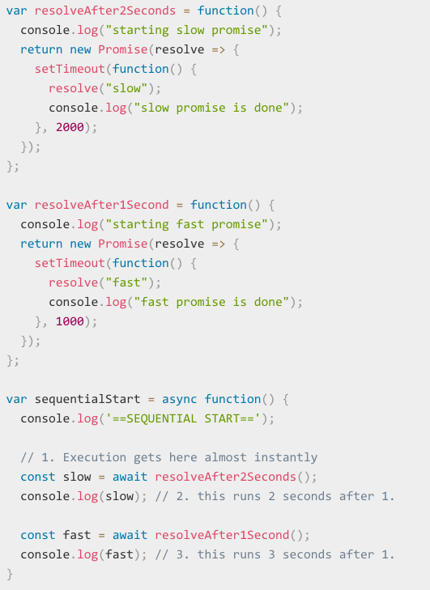
async and await example
Functions return promises
async function
await pauses function execution until promise returned is resolved
Notes:
can make code very difficult to read. Async Await is a way to fix this problem and make the code easily readable.

Slide 12
async/await explanation
In the previous example the following lines:
const slow = await resolveAfter2Seconds();
const fast = await resolveAfter1Seconds();
Is equivalent to chaining the promises:
resolveAfter2Seconds().then(val => {
const slow = val;
console.log(slow);
return resolveAfter1Seconds();
}).then(val => {
const fast = val;
console.log(fast);
});

Slide 13
async/await
await can only be used in functions that are declared with async
await can only be used to call functions which return a Promise
await will execute then() on the returned promise
await will cause the call to then() to wait and not proceed until it is resolved

Slide 14
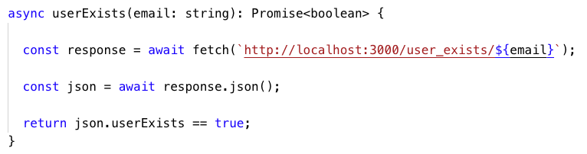
Returning values from an async function
async functions can only return Promises
In the example below the returned boolean will be wrapped in a Promise:
success: boolean = await userExists("j.faichney@griffith.edu.au");
Returned boolean will be automatically wrapped in a Promise
returns a boolean

Slide 15
Observables and Promises

Slide 16
Observables and Promises
As mentioned Observables are different to Promises, primarily in that they handle multiple events, whereas Promises only execute once
However, what if you wanted to converted a Promise to an Observable?
RxJS has a powerful from function which can be used to convert many different things into Observables
It is primarily used for iterable objects, e.g. arrays, where each array element will be passed to the function of the observer, in sequence
However it can also be used to convert a promise to an observable
Notes:
it can also be used to convert a promise to an observable

Slide 17
Converting a Promise to an Observable using from
In this example we convert the Promise returned from the fetch function into an Observable:
const data = from(fetch('/api/endpoint'));
data.subscribe({
next(response) {
console.log(response);
},
error(err) {
console.error('Error: ' + err);
},
complete() {
console.log('Completed');
}
});

